Slide 1

Class Library

Slide 2
What is it (not)?

Slide 3
What is it not?
A ready-made App to use out-of-the-box
An Object-Relationship Mapper (ORM)
A framework for creating GUIs
A framework for creating server-side Apps

Slide 4
What is it?
A number (30 p.t.) of small class libraies
C# code only (no XAML/SQL)
A toolbox for students, specifically for 1. + 2.semester final projects
Aimed at Apps with MVVM architecture
Mostly aimed at the Model and ViewModel layer

Slide 5
App
View
MVVM Starter
ViewModel
Server
Model
Web Service
Entity Framework
Database

Slide 6
Why?

Slide 7
Why?
Steep learning curve on 1.semester
Manage infrastructure complexity
Assist in boilerplate implementation of CRUD operations
More time/focus on domain logic
Can be used fully, in parts, as inspiration, or not at all

Slide 8
Overview

Slide 9
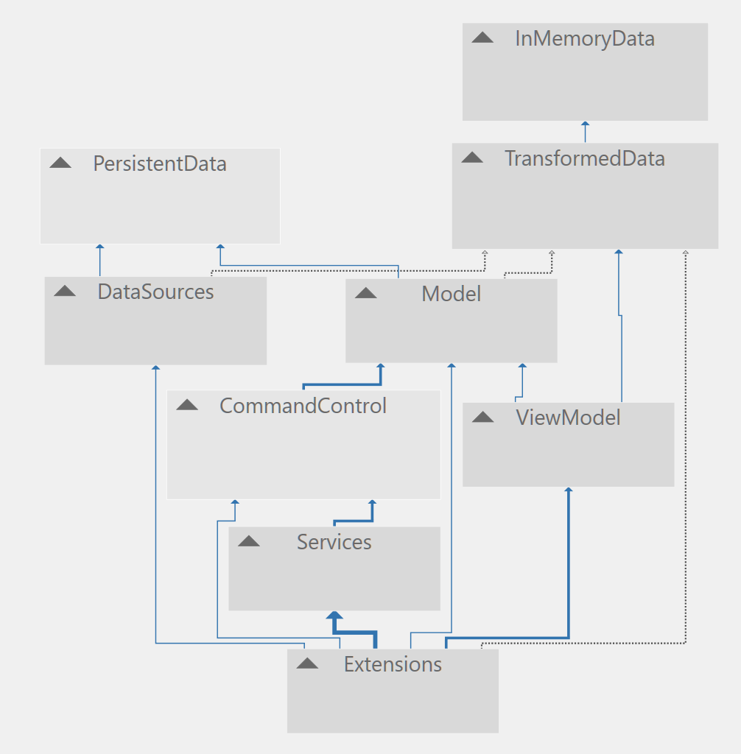

Slide 10
ViewModel
Catalog
Collection
DataSource
Domain class
Persistence

Slide 11
Data stereotypes
Domain objects (type T). Classic domain object, without any consideration for user interaction or transport/persistency
ViewModel domain objects (type TVMO). Transformation of domain object, aimed at being interacted with by ViewModel classes, like ItemViewModel and DetailsViewModel
Data transport objects (type TDTO). Transformation of domain object, aimed at being transported/persisted

Slide 12
Domain classes
(T)

Slide 13
View Model
domain classes
(TVMO)
Domain classes
(T)
Data transport classes
(TDTO)

Slide 14
View Model
domain classes
(TVMO)
Domain classes
(T)
Data transport classes
(TDTO)
Factory<T, TVMO>
Factory<T, TDTO>

Slide 15
Data

Slide 16
Data representation
InMemoryData: Domain data, constructed at run-time
TransformedData: Various run-time trans-formations between data representations (domain data to persistent data, etc.)
PersistentData: Data in persisted form, no assumptions about specific media
InMemoryData
TransformedData
PersistentData

Slide 17
InMemoryData

Slide 18
IStorable/StorableBase
All (domain) objects stored in memory are assigned a per-type unique key
Keys are per default managed by the library classes – can be overrided
Domain classes should inherit from StorableBase
IStorable
int Key { get; set; }
StorableBase
int Key { get; set; }

Slide 19
IInMemoryCollection<T>
List<T> All { get; }
void Insert(T obj);
T Get(int key);
void Remove(int key);
void InsertAll(List<T> objects);
void ReplaceAll(List<T> object);
void RemoveAll();
InMemoryCollection
Domain data of type T is stored in-memory in collections of this type
Collection will per default manage key assignment to domain objects
Does not know anything about other (transformed) data representations
Does not know anything about persistency
Will typically be used when creating a type-specific catalog
InMemoryCollection<T>

Slide 20
TransformedData

Slide 21
ITransformed/TransformedBase
Represents an object which is a trans-formation of an object of type T
T is typically a domain class type
Transformation is used e.g. in a view or persistent source
Clone creates exact (shallow) copy; implemented in TransformedBase
SetValuesFromObject is intended to set property values in transformed object, using an object of the original type T as source for values.
SetValuesFromObject is abstract in TransformedBase – deferred to specific transformation classes
ITransformed<T>
ITransformed<T> Clone();
void SetValuesFromObject(T obj);
TransformedBase<T>
ITransformed<T> Clone();
void SetValuesFromObject(T obj);

Slide 22
TransformedWithDefaultBase
Adds option to set default values in a transformed object
Useful if transformed object is used as e.g. a view model, where initial values should be displayed in a view
SetDefaultValues is abstract in TransformedWithDefaultBase – deferred to specific transformation classes
ITransformedWithDefault<T>
void SetDefaultValues();
TransformedWithDefaultBase<T>
protected TransformedWithDefaultBase()
{
SetDefaultValues();
}

Slide 23
IFactory/FactoryBase
Represents a ”factory”, which can produce a transformed object (of type TTDO) from a domain object of type T, and vice versa.
Catalog classes will need to be able to transform back and forth between these representations, and will therefore refer to factory objects
FactoryBase implements all methods except CreateDomainObject – deferred to type-specific factory classes
IFactory<T, TTDO>
TTDO CreateTransformedObject(T obj);
T CreateDomainObject(TTDO tObj);
List<TTDO> CreateTransformedObjects(List<T> objects);
List<T> CreateDomainObjects(List<TTDO> tObjects);
FactoryBase<T, TTDO>

Slide 24
If no transformation is needed, a no-transformation factory IdenticalDataFactory is available
public class IdenticalDataFactory<T> : FactoryBase<T, T>
{
public override T CreateDomainObject(T obj)
{
return obj;
}
}

Slide 25
IDataWrapper/DataWrapper
Some classes will ”wrap” around a trans-formed data object, e.g. an Item View model object
Such classes should implement the IDataWrapper interface (or inherit from DataWrapper)
IDataWrapper<TTDO>
TTDO DataObject { get; }
DataWrapper<TTDO>

Slide 26
PersistentData

Slide 27
IPersistentSource
Interface for any persistent data source
TDTO: Data Transfer Object (DTO) type
DTO will typically be a transformation of domain data
All methods can be invoked asynchronously
A persistent source may offer CRUD function-ality and/or Load/Save functionality
NOTE: A specific data source may not support all operations in interface! Should throw an exception if unsupported operation is invoked
Need to anticipate this in an implementation using a specific source
IPersistentSource<TDTO>
Task Save(List<TDTO> objects);
Task<List<TDTO>> Load();
Task Create(TDTO obj);
Task<TDTO> Read(int key);
Task Update(int key, TDTO obj);
Task Delete(int key);

Slide 28
PersistencyManager
If a class – typically a catalog – wants to be ”loaded” when an application-wide Load operation is performed, it can register a method at the LoadDelegate event (likewise for Save)
Invoking LoadAll/SaveAll will then invoke all registered methods
The PersistencyManager class implements the interface as a singleton
IPersistencyManager
event Action<bool> LoadDelegate;
event Action<bool> SaveDelegate;
void LoadAll();
void SaveAll();
<<Singleton>>
PersistencyManager

Slide 29
PersistentOperations
Enumeration of all well-defined operations relating to persistency
public enum PersistencyOperations
{
Load,
Save,
Create,
Read,
Update,
Delete
}

Slide 30
IStringPersistence/IStringConverter
Interfaces relating specifically to string-based persistency
Will typically be implemented if a file-based data source is used
IStringPersistence
Task SaveAsync(string source, string data);
Task<string> LoadAsync(string source);
IStringConverter<T>
string ConvertToString(List<T> objects);
List<T> ConvertFromString(string data)

Slide 31
Model

Slide 32
View Model classes
(TVMO data types)
<TVMO>
Catalog<T, TVMO, TDTO>
Factory<T, TVMO>
<T>
InMemoryCollection<T>
<T>
Factory<T, TDTO>
<TDTO>
Persistent Data classes
(TDTO data types)

Slide 33
ICatalog/Catalog
A catalog is a pivotal class in an application based on the MVVM architecture
The catalog forms the bridge between View Model classes and Persistency classes
Implementation contains instance fields for in-memory collection, data source and factories for data transformations
Catalog supports CRUD operations
ICatalog<TVMO>
List<TVMO> All { get; }
void Create(TVMO obj);
TVMO Read(int key);
void Update(TVMO obj, int key);
void Delete(int key);
Catalog<T, TVMO, TDTO>

Slide 34
IMonitorableCatalog
Interface for making a catalog ”monitorable”, i.e. a client can be notified about changes in the state of the catalog
Client can register callbacks for Create, Update and Delete operations
Catalog implementation also supports this interface
IMonitorableCatalog
void AddOnObjectCreatedCallback(Action callback);
void AddOnObjectUpdatedCallback(Action callback);
void AddOnObjectDeletedCallback(Action callback);

Slide 35
IMonitorableCatalog
ICatalog<TVMO>
Catalog<T, TVMO, TDTO>
protected IInMemoryCollection<T> _collection;
protected IPersistentSource<TDTO> _source;
protected IFactory<T, TVMO> _vmoFactory;
protected IFactory<T, TDTO> _dtoFactory;
protected List<PersistencyOperations> _supportedOperations;
public event Action OnObjectCreated;
public event Action OnObjectDeleted;
public event Action OnObjectUpdated;

Slide 36
IPersistableCatalog
Interface for making the catalog support ”mass persistency”, i.e. Load/Save operations
NOTE: The data source aggregated by the catalog may not support these operations, and may thus throw exceptions
IPersistableCatalog
void Load();
void Save();

Slide 37
IManagedCatalog
Interface for making a catalog ”managed”, i.e. the catalog will register its Load/Save methods at the PersistencyManager, thereby ”opting in” in application-wide Load/Save operations
IManagedCatalog
void Manage();

Slide 38
Catalog<T, TVMO, TDTO>
IPersistableCatalog
IManagedCatalog
PersistableCatalog<T, TVMO, TDTO>
void Load();
void Save();
void Manage();

Slide 39
ViewModel

Slide 40

View
AX 43 520
Location
Berlin
In EU now
Yes

Slide 41
MasterDetails
ViewModel
ObservableCollection
<ItemViewModel>
Details
ViewModel
Item
ViewModel

Slide 42
MasterDetails
ViewModel
ObservableCollection
<IDataWrapper<TVMO>>
IDataWrapper<TVMO>
IDataWrapper<TVMO>

Slide 43
MasterDetails
ViewModel
ObservableCollection
<IDataWrapper<TVMO>>
IDataWrapper<TVMO>
IDataWrapper<TVMO>
TVMO
TVMO

Slide 44
IMasterDetailsViewModel
Interface for ViewModel for minimal Master/ Details view
Holds together a collection of ”selectable items”, a selected item, and details for selected item
Makes no assumptions about how elements interact
Makes no assumptions about available commands, etc..
IMasterDetailsViewModel<TVMO>
ObservableCollection<IDataWrapper<TVMO>> ItemCollection { get; }
IDataWrapper<TVMO> ItemSelected { get; set; }
IDataWrapper<TVMO> ItemDetails { get; set; };

Slide 45
ItemViewModel interfaces
Some simplistic interfaces for Item ViewModel classes
No requirement to use these for imple-mentation of specific Item ViewModel classes
Any implementation of Item ViewModel classes must inherit from IDataWrapper
IItemViewModelImage
string ImageSource { get; }
Visibility ImageVisibility { get; }
int ImageSize { get; }
IItemViewModelDescription
string Description { get; }
int FontSize { get; }

Slide 46
IViewModelFactory<TVMO>
IDataWrapper<TVMO> CreateDetailsViewModel(TVMO obj);
IDataWrapper<TVMO> CreateItemViewModel(TVMO obj);
IDataWrapper<TVMO> CreateDetailsViewModelFromNewVMO();
IDataWrapper<TVMO> CreateDetailsViewModelFromClonedVMO(TVMO obj);
ObservableCollection<IDataWrapper<TVMO>> CreateItemViewModelCollection(IEnumerable<TVMO> dataObjects);

Slide 47
IViewModelFactory
Interface for factory producing Item ViewModel and Details ViewModel objects.
Note: Not a factory for producing type-specific VMOs
Both Item and Details ViewModel objects will ”wrap” around a type-specific VMO
IViewModelFactory<TVMO>

Slide 48
IMDVMMediator
Interface for a ”mediator”, which will implement a spe-cific strategy for how the elements in a MasterDetails-ViewModel object should interact
Reacts to changes in item selection, and changes in the underlying catalog
IMasterDetailsViewModelMediator<TVMO>
void OnItemSelectionChanged(IDataWrapper<TVMO> vmoWrapper);
void OnCatalogChanged();

Slide 49
ItemViewModelBase
Class implements the two Item-oriented interfaces, and inherits from DataWrapper
Not required to use this class in specific implementation; only requirement for an Item ViewModel class is to implement the IDataWrapper interface
ItemViewModelBase<TVMO>
virtual string Description { get {…}}
virtual string ImageSource { get {…}}
virtual int FontSize { get {…}}
virtual int ImageSize { get {…}}
virtual Visibility ImageVisibility { get {…}}

Slide 50
DetailsViewModelBase
Class inherits from DataWrapper
Class also implements the INotifyProperty-Changed interface (default implementation)
Not required to use this class in specific implementation; only requirement for a Details ViewModel class is to implement the IDataWrapper interface
DetailsViewModelBase<TVMO>

Slide 51
ViewModelFactoryBase
Class implements the methods in the IViewModelFactory interface
Note that the two methods CreateDetailsViewModel and CreateItemViewModel are left as being abstract
Implementation is deferred to type-specific factory classes
ViewModelFactoryBase<T, TVMO>
abstract IDataWrapper<TVMO> CreateDetailsViewModel(TVMO obj);
abstract IDataWrapper<TVMO> CreateItemViewModel(TVMO obj);

Slide 52
IMasterDetailsViewModel<TVMO>
IDataWrapper<TVMO>
MasterDetailsViewModelBase<T, TVMO>
protected ICatalog<TVMO> Catalog;
protected IViewModelFactory<TVMO> ViewModelFactory;
private IDataWrapper<TVMO> _itemDetails;
private IDataWrapper<TVMO> _itemSelected;
TVMO DataObject { get {…} }
ObservableCollection<IDataWrapper<TVMO>> ItemCollection { get {…} }
IDataWrapper<TVMO> ItemSelected
IDataWrapper<TVMO> ItemDetails

Slide 53
MasterDetailsViewModelBase
Provides a ”context-free” implementation of the IMasterDetailsViewModel interface
No assumptions about specific actions taken, when e.g. selection changes or catalog is updated
Provides properties to which a View can bind GUI controls
Also implements IDataWrapper interface; item currently selected is considered to be the ”wrapped” VMO
MasterDetailsViewModelBase<T, TVMO>

Slide 54
DataSources

Slide 55
FileJSON

Slide 56
FileSource
Implements file-based persistency
Data is saved in string format
NOTE: This implementation does not support CRUD operations, only Load and Save operations
Relies on interfaces IStringPersistence and IStringConverter
Does not assume any specific data formats or file management strategy
IPersistentSource<TDTO>
Task Save(List<TDTO> objects);
Task<List<TDTO>> Load();
Task Create(TDTO obj);
Task<TDTO> Read(int key);
Task Update(int key, TDTO obj);
Task Delete(int key);
FileSource<TDTO>

Slide 57
IStringConverter<TDTO>
string ConvertToString(List<TDTO> objects);
List<TDTO> ConvertFromString(string data)
IStringPersistence
Task SaveAsync(string source, string data);
Task<string> LoadAsync(string source);
JSONConverter<TDTO>
FileStringPersistence

Slide 58
WebAPI

Slide 59
WebAPISource
Implements persistency based on RESTful Web Service
Uses HTTPClient class for invoking web service REST API calls
NOTE: This implementation does not support the Save operation
Class is a Web Service client; a server for the Web Service must be made available separately
IPersistentSource<TDTO>
Task Save(List<TDTO> objects);
Task<List<TDTO>> Load();
Task Create(TDTO obj);
Task<TDTO> Read(int key);
Task Update(int key, TDTO obj);
Task Delete(int key);
WebAPISource<TDTO>

Slide 60
CommandControl

Slide 61
Controllers

Slide 62
ISimpleController
Very simplistic interface for any controller-like class
ISimpleController
void Run();

Slide 63
Commands

Slide 64
Command interfaces/classes
Extension of the ”standard” RelayCommand class with RaiseCanExecuteChanged
ICommand
INotifiableCommand
void RaiseCanExecuteChanged();
RelayCommand
event EventHandler CanExecuteChanged;
bool CanExecute(…);
void Execute();
void RaiseCanExecuteChanged();

Slide 65
ICommandManager/CommandManager
A Command Manager simply holds a set of INotifiableCommand objects
New command objects can be added
The entire set of command objects can be retrieved
All command objects can be ”notified”, meaning they should re-evaluate the status of the CanExecute predicate
ICommandManager
void AddCommand(string key, INotifiableCommand command);
Dictionary<string, INotifiableCommand> Commands { get; }
void Notify();
CommandManager

Slide 66
DataControllers

Slide 67
CRUDControllerBase
Base class holds together a Source and a Target, to be used in the operation performed by the controller
Source has type IDataWrapper<TVMO>
Target has type ICatalog<TVMO>
Subclasses implement the specific operation to perform
ISimpleController
CRUDControllerBase<TVMO>
protected IDataWrapper<TVMO> Source;
protected ICatalog<TVMO> Target;

Slide 68
…ControllerBase
Implements the specific CRUD operation to perform
Overrides the Run method
Similar implementation for all three sub-classes (Create, Update, Delete)
CRUDControllerBase<TVMO>
CreateControllerBase<TVMO>
public override void Run() {…}

Slide 69
…Controller<TVMO>
Source
(IDataWrapper<TVMO>)
Target
(ICatalog<TVMO>)
DataObject
(TVMO)

Slide 70
// Create
public override void Run()
{
Target.Create(Source.DataObject);
}
// Update
public override void Run()
{
Target.Update(Source.DataObject, Source.DataObject.Key);
}
// Delete
public override void Run()
{
Target.Delete(Source.DataObject.Key);
}
CRUDControllerBase<TVMO>
CreateControllerBase<TVMO>
public override void Run() {…}

Slide 71
DataCommands

Slide 72
CRUDCommandBase
Holds together a (simple) controller and a condition for the controller to run
public void Execute()
{
Controller.Run();
}
public bool CanExecute()
{
return Condition();
}
INotifiableCommand
CRUDCommandBase
protected ISimpleController Controller;
protected Func<bool> Condition;

Slide 73
…CommandBase
Invokes the base class constructor with an operation-specific controller
A Source and Target are given as parameters to constructor; these are used when creating operation-specific controller
Source has type IDataWrapper<TVMO>
Target has type ICatalog<TVMO>
Same implementation for Update and Delete operations
CRUDCommandBase
protected ISimpleController Controller;
protected Func<bool> Condition;
CreateCommandBase<TVMO>

Slide 74
CRUDCommandManager
Implements a command manager specifically aimed at CRUD operations
Holds three command objects (Create, Update, Delete)
Also contain three predicates CanDo…, defining if an operation can execute
Three abstract predicates Further… allow sub-classes to add additional conditions for execution of an operation
CommandManager
CRUDCommandManager<T, TVMO>
bool CanDoCreate();
bool CanDoUpdate();
bool CanDoDelete();
abstract bool FurtherConditionCreate();
abstract bool FurtherConditionUpdate();
abstract bool FurtherConditionDelete();

Slide 75
Extensions

Slide 76
ExtensionsCommands

Slide 77
public class CRUDStates
{
public const string CreateState = "CreateState";
public const string ReadState = "ReadState";
public const string UpdateState = "UpdateState";
public const string DeleteState = "DeleteState";
}
public class CRUDStateCommands
{
public const string CreateStateCommand = "CreateStateCommand";
public const string ReadStateCommand = "ReadStateCommand";
public const string UpdateStateCommand = "UpdateStateCommand";
public const string DeleteStateCommand = "DeleteStateCommand";
}
CRUDStates
CRUDStateCommands

Slide 78
Class implements a command manager, specifically for selecting a ”view state”
NOTE: This class is not related to exe-cution of a CRUD command, but to selecting a view state
Can be useful if a single View can be in several ”states”, depending on the CRUD operation the user wishes to perform
Commands can then be bound to e.g. a RadioButton in the View
CommandManager
CRUDViewStateSelectCommandManager
private IViewStateService _stateService;

Slide 79
Class adds further conditions to the predicates deciding if a CRUD command can be executed
A CRUD command can now only be executed, if the view is in the correspon-ding view state
CRUDCommandManager<T, TVMO>
CRUDCommandManagerViewStateDependent
IHasViewState _viewStateObject;
override bool FurtherConditionCreate()
override bool FurtherConditionUpdate()
override bool FurtherConditionDelete()

Slide 80
ExtensionsModel

Slide 81
FilePersistableCatalog
Class injects specific dependencies into the PersistableCatalog class, making it a catalog using file-based persistency
Specific dependencies:
InMemoryCollection<T>
FileSource<TDTO>, using
FileStringPersistence
JSONConverter<TDTO>
Two factories (T, TDTO) and (T, TVMO) are injected through the constructor, since they will be type-specific
Catalog only supports Load and Save
PersistableCatalog<T, TVMO, TDTO>
FilePersistableCatalog<T, TVMO, TDTO>

Slide 82
WebAPIPersistableCatalog
Class injects specific dependencies into the PersistableCatalog class, making it a catalog using persistency based on calls to a RESTful web service (catalog acts as a web service client)
Specific dependencies
InMemoryCollection<T>
WebAPISource<TDTO>
Two factories (T, TDTO) and (T, TVMO) are injected through the constructor, since they will be type-specific
Catalog supports all persistency opera-tions except Save
PersistableCatalog<T, TVMO, TDTO>
WebAPIPersistableCatalog<T, TVMO, TDTO>

Slide 83
ExtensionsServices

Slide 84
ViewModel extenstion classes
ImageViewModel class is a ViewModel class for the Image service.
If you want to include a GUI for the Image service in an application, the GUI can bind the view controls to properties in this class.
SecurityViewModel class is a View-Model class for the Security service.
If you want to include a GUI for the Security service in an application, the GUI can bind the view controls to properties in this class.
ImageViewModel
SecurityViewModel

Slide 85
ServiceProvider
ServiceProvider class is intended to be the access point for services offered in an application
Class currently only includes Image and Security services, but can be extended
ServiceProvider
static IImageService Images
static ISecurityService Security

Slide 86
ExtensionsViewModel

Slide 87
public class CRUDControls
{
public const string CreateControl = "CreateControl";
public const string UpdateControl = "UpdateControl";
public const string DeleteControl = "DeleteControl";
public const string ItemSelectorControl = ”ItemSelectorControl";
}
public class CRUDStateControls
{
public const string CreateStateControl = "CreateStateControl";
public const string ReadStateControl = "ReadStateControl";
public const string UpdateStateControl = "UpdateStateControl";
public const string DeleteStateControl = "DeleteStateControl";
}
CRUDControls
CRUDStateControls

Slide 88
ICRUDControlStateService
Interface contains methods for setting default behaviors for controls, for an entire set of controls in one call
Useful if most/all controls in a View have the same behavior with regards to visibility, enable/disable, etc..
IControlStateService
ICRUDControlStateService
void AddImmutableControlsDefaultStates(List<string> ids);
void AddMutableControlsDefaultStates(List<string> ids);
void AddCRUDInvokerDefaultStates();
void AddStateSelectorDefaultStates();
void AddItemSelectorDefaultStates();

Slide 89
CRUDControlStateService
Class provides a default implementation of control state setup for a CRUD view
A typical control could be a TextBox, but also ListBox, etc..
Default behaviors are:
Create state: Control is enabled
Read state: Control is disabled
Update state: Control state as specified by control ”mutability”
Delete state: Control is disabled
ICRUDControlStateService
CRUDControlStateService

Slide 90
public class CRUDViewStateService : ViewStateService
{
public CRUDViewStateService() : base(new List<string>
{
CRUDStates.CreateState,
CRUDStates.ReadState,
CRUDStates.UpdateState,
CRUDStates.DeleteState
})
{}
}
ViewStateService
CRUDViewStateService

Slide 91
ItemViewModelWithImage
Base class implementation for an Item ViewModel class containing a image, provided by the Images service.
The image is identified by a numeric key (ImageKey).
ItemViewModelBase<TVMO>
ItemViewModelWithImage<TVMO>
private IImage _notFoundImage;
override string ImageSource { get{…} }
abstract int ImageKey { get; }

Slide 92
DetailsViewModelWith…
Base class implementation for a Details ViewModel class, where an image can be selected
The set of selectable image objects are provided by the Images service.
The image is identified by a numeric key (ImageKey).
DetailsViewModelBase<TVMO>
DetailsViewModelWithSelectableImage<TVMO>
ObservableCollection<IImage> ImageCollection { get {…}};
IImage ImageSelected { get {…} set {…}};
abstract int ImageKey { get; }

Slide 93
Mediator interfaces
Extends the mediator interface with an option to respond to changes in view state
Relevant for Views with state, e.g. CRUD view states
IMasterDetailsViewModelMediator<TVMO>
void OnItemSelectionChanged(IDataWrapper<TVMO> vmoWrapper);
void OnCatalogChanged();
IMasterDetailsViewModelWithStateMediator<TVMO>
void OnViewStateChanged();

Slide 94
Mediator implementation
Class implements a specific strategy for mediating between the elements in a Master/Details ViewModel with view state
IMasterDetailsViewModelWithStateMediator<TVMO>
MasterDetailsViewModelWithStateMediator<TVMO>
void OnItemSelectionChanged(IDataWrapper<TVMO> vmoWrapper);
void OnCatalogChanged();
void OnViewStateChanged();

Slide 95
public void OnItemSelectionChanged(IDataWrapper<TVMO>)
{
// If in the Update state, the Details ViewModel object
// will now refer to a clone of the selected VMO.
// Otherwise, the Details ViewModel object will refer
// directly to the selected VMO.
}
public void OnCatalogChanged()
{
// If the underlying catalog changes, the Item selection
// is set to null (no selection). The ItemCollection
// property is also notified, such that Views binding
// to this property can re-read the collection.
// If in the Create state, set the Details to refer to a
// fresh Details ViewModel object. This object will be
// populated with default values.
}
public void OnViewStateChanged()
{
// If in the Create state, set the Details to refer
// to a fresh Details ViewModel object. This object
// will be populated with default values.
// If in the Update state - and an Item is selected -
// the Details ViewModel object will now refer to a
// clone of the selected VMO.
// All commands are notified.
// Control states should be re-read,
// since they may depend on view state.
}
IMDVMWSM<TVMO>
MDVMWSM<TVMO>
void OnItemSelectionChanged(…);
void OnCatalogChanged();
void OnViewStateChanged();

Slide 96
MDVMWithState
Class adds properties to the base Master/Details view model class
Added properties for
View State Service
Control State Service
Data Commands (command invocation)
State Commands (view state change)
Mediator
Class does not assume any specific implementations of view states, data commands or mediator
MasterDetailsViewModelBase<T, TVMO>
MasterDetailsViewModelWithState<T, TVMO>
IControlStateService ControlStateService;
IViewStateService ViewStateService;
ICommandManager DataCommandManager;
ICommandManager StateCommandManager;
Dictionary<string, INotifiableCommand> StateCommand;
Dictionary<string, INotifiableCommand> DataCommand;
Dictionary<string, IControlState> ControlStates;
string ViewState;
IMasterDetailsViewModelWithStateMediator<TVMO> Mediator;

Slide 97
MDVMCRUD
Class adds specific dependencies of CRUD-specific implementations
Adds CRUD-specific implementations of
View State Service
Control State Service
Data Commands (command invocation)
State Commands (view state change)
Mediator
Type-specific Master/Details View Model classes can inherit from this class
MasterDetailsViewModelWithState<T, TVMO>
MasterDetailsViewModelCRUD<T, TVMO>

Slide 98
Services

Slide 99
ControlState (not ready yet…)

Slide 100
ViewState (not ready yet…)

Slide 101
PropertyDependency (not ready yet…)

Slide 102
Validation (not ready yet…)

Slide 103
UI (not ready yet…)

Slide 104
Filtering (not ready yet…)

Slide 105
Images (not ready yet…)

Slide 106
Security (not ready yet…)

Slide 107
End

Slide 108

https://github.com/perl-easj/MVVMStarterLibrary

